Slide 1
STOR 455 Model Diagnostics: Residuals
Read: 1.5
Exercises: #1.33, 43, 47

Slide 2
Single Quantitative Predictor Model
Notation: Y = Response variable
X = Predictor variable
Assume (for now) that both Y and X are quantitative variables.

Slide 3
Simple Linear Model
X = Single quantitative predictor
Y = Quantitative response
Find a line that best summarizes the trend in the data.
Y
X

Slide 4
Simple Linear Model
response
random error
Y = β_{o} + β₁X + ε
intercept
predictor
slope
Assume: ε ~ N( 0, σ_{ε}) and independent
Three parameters to estimate: β_{o}, β₁, σ_{ε}

Slide 5
Simple Linear Model- Conditions
Model:
Linearity: The means for Y vary as a linear function of X.
Error:
Zero Mean: The distribution of the errors is centered at zero.
Constant variance: The variance for Y is the same at each X. (Homoscedasticity)
Independence: No relationships among errors.
Normality:
Residuals are normally distributed
(sometimes) At each X, the Y’s follow a normal distribution.

Slide 6
What to do when regression assumptions are violated?
Examples:
Nonlinear patterns in residuals
Heteroscedasticity (nonconstant variance)
Lack of normality in residuals
Outliers: influential points, large residuals

Slide 7
Types of “Unusual” Points in SLM
Outlier: A data point that is far from the regression line.
Influential point: A data point that has a large effect on the regression fit.
How do we measure “far”?
How do we measure “effect on the fit”?

Slide 8
Detecting Unusual Cases - Overview
1. Compute residuals
“raw”, standardized, studentized
2. Plots of residuals (or std. residuals)
Boxplot, scatterplot, normal plot
3. Leverage
Unusual values for the predictors
4. Cook’s distance
Cases with large influence

Slide 9
Raw Residual
How can we tell if a residual is unusually large?
Example:
Y = GPA e_{i} = 2.6 is very large
Y = SAT e_{i} = 2.6 is very small

Slide 10
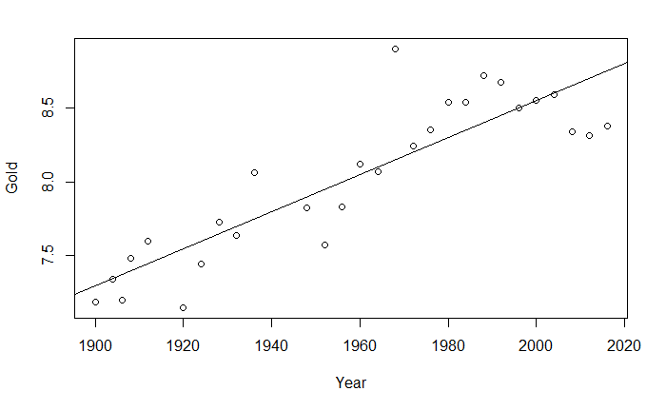
Example: Men’s Olympic Long Jump
LongJumpOlympics2016
Bob Beamon (1968)

Slide 11
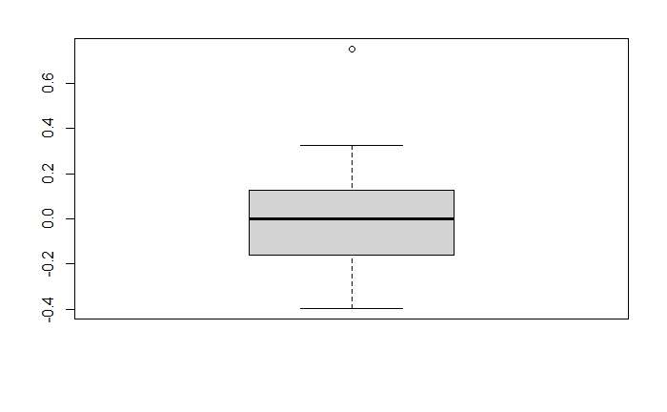
Outliers are more than 1.5 IQR’s beyond the Quartiles
1.5⋅IQR
Q₃
IQR
m
1.5⋅IQR
Q₁

Slide 12
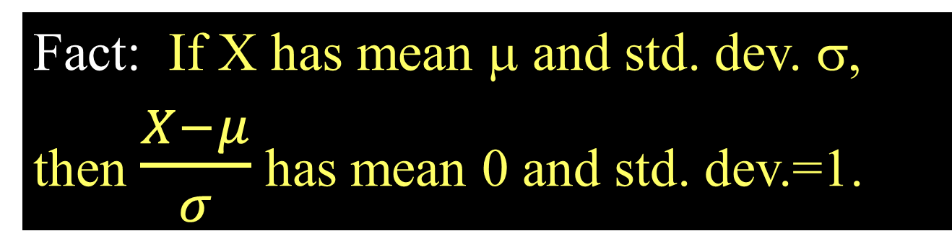

Standardized Residuals
Fact: If X has mean μ and std. dev. σ,
then $\frac{X−μ}{σ}$ has mean 0 and std. dev.=1.
For residuals: mean=0 and std. dev. $≈{\hat{σ}}_{ε}$
Standardized
Residual ≈
Look for values
beyond ±2 (mild) or beyond ±3
(almost)

Slide 13
Standardized Residuals in R
Once you have fit mymodel=lm(Y~X)
Use: rstandard(mymodel)
GoldModel=lm(Gold~Year,data=LongJumpOlympics2016)
rstandard(GoldModel)
1 2 3 4 5 6
-0.45846037 -0.02447194 -0.69927805 0.34245659 0.62395356 -1.58872766
7 8 9 10 11 12
-0.60354515 0.33349306 -0.22282237 1.24041457 -0.28038843 -1.47783119
13 14 15 16 17 18
-0.65303672 0.28865616 -0.10391829 2.96025507 0.17095826 0.40756162
19 20 21 22 23 24
0.96124413 0.76569814 1.28443310 0.89029407 0.01303494 0.01295953
25 26 27 28
-0.02754601 -1.24791995 -1.58338033 -1.51206192
max(rstandard(GoldModel))
[1] 3.02588100

Slide 14
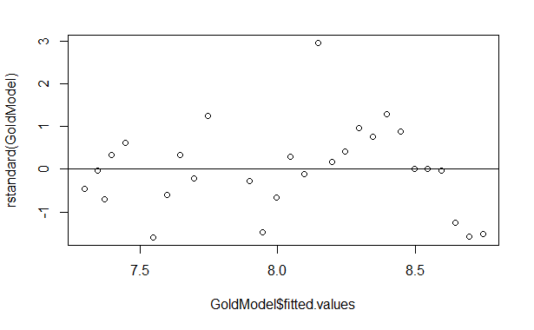
Plot: Standardized Residuals vs. Predicted
2.96

Slide 15

Studentized Residual
Concern: An unusual value may exert great influence on the fit
⇒ Its residual might be underestimated because the model “moves” a lot to fit it
and/or
⇒ The standard error of regression may be inflated due to the outlier error
Studentize: Fit the model without that case, then find new $y−\hat{y}$ and ${\hat{σ}}_{ε}$ to standardize.
R does this for every point!

Slide 16
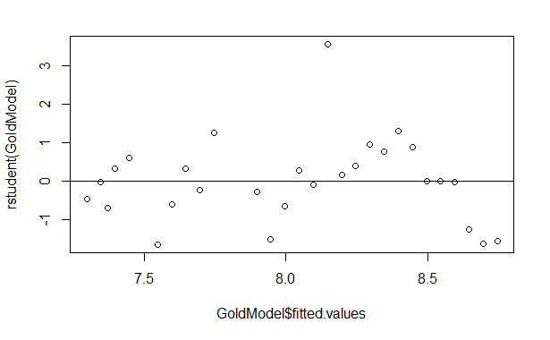
Plot: Studentized Residuals vs. Predicted
3.57

Slide 17
Influence
The effect of a single data point on the regression line depends on:
how well it matches the “trend” of the rest of the points
how “unusual” is its predictor value

Slide 18
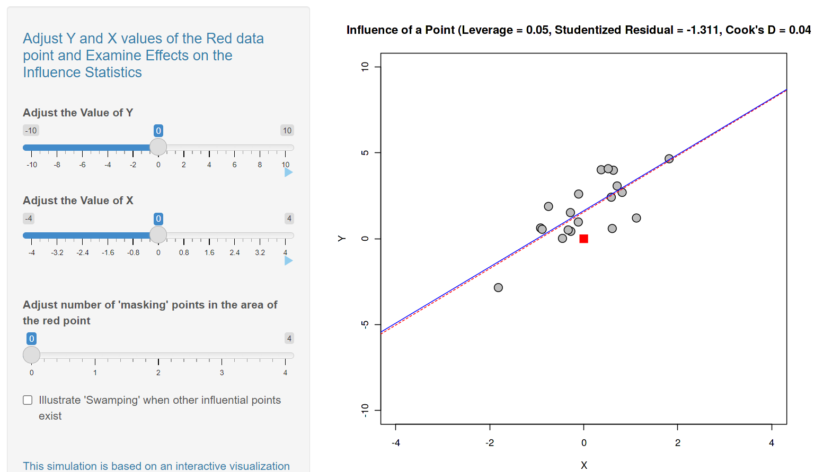
Influence App

Slide 19

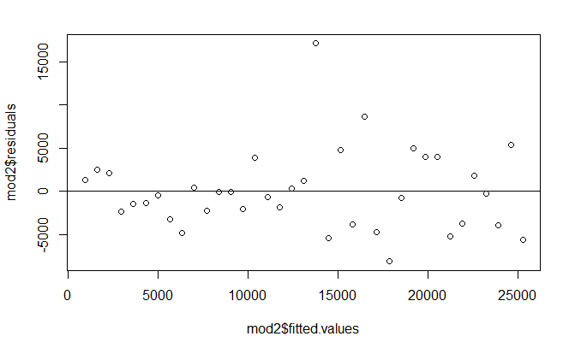
Artic Sea Ice
max(rstandard(IceModel3))
max(rstudent(IceModel3))
[1] 3.659516
[1] 4.590462

Slide 20
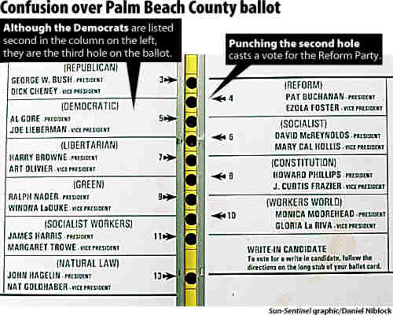
Example: Palm Beach Butterfly Ballot
2000 U.S. Presidential Election: Florida
George Bush 2,912,790
Al Gore 2,912,253

Slide 21
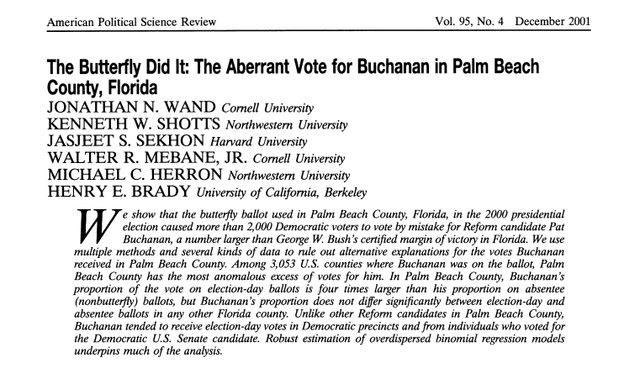
Example: Palm Beach Butterfly Ballot

Slide 22
Dataset: PalmBeach
County vote counts in Florida (n=67) for George Bush and Pat Buchanan in 2000.
Model: Use Bush votes to predict Buchanan votes.
data(PalmBeach)
ElectionModel=lm(Buchanan~Bush,data=PalmBeach)
plot(Buchanan~Bush,data=PalmBeach)
abline(ElectionModel)

Slide 23
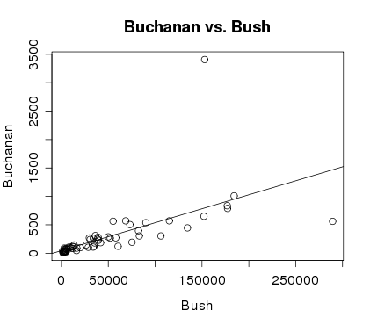
Example: Palm Beach Butterfly Ballot
Palm Beach

Slide 24
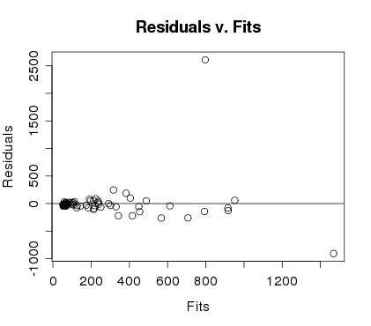
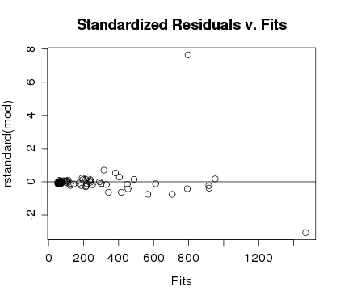
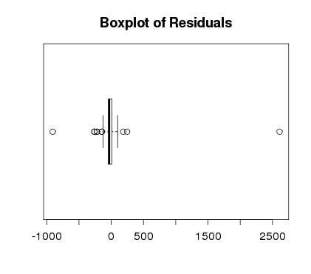
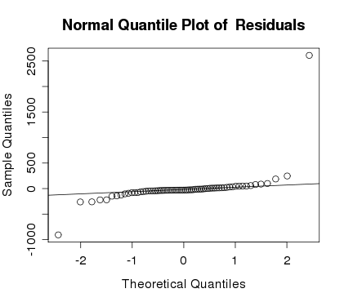
Ballot Residuals

Slide 25
What to do with an extreme residual?
Try a transformation
Redo the analysis with the point omitted
newdata=subset(PalmBeach,County!="PALM BEACH")
“not equal to”

Slide 26
Model with/without Palm Beach
ElectionModel = lm(Buchanan~Bush,data=PalmBeach)
newdata=subset(PalmBeach,County!=”PALM BEACH”)
ElectionModel_noPB = lm(Buchanan~Bush,data=newdata)
summary(ElectionModel)
Estimate Std. Error t value Pr(>|t|)
(Intercept) 4.529e+01 5.448e+01 0.831 0.409
Bush 4.917e-03 7.644e-04 6.432 1.73e-08 ***
Residual standard error: 353.9 on 65 degrees of freedom
summary(ElectionModel_noPB)
Estimate Std. Error t value Pr(>|t|)
(Intercept) 6.557e+01 1.733e+01 3.784 0.000343 ***
Bush 3.482e-03 2.501e-04 13.923 < 2e-16 ***
Residual standard error: 112.5 on 64 degrees of freedom

Slide 27
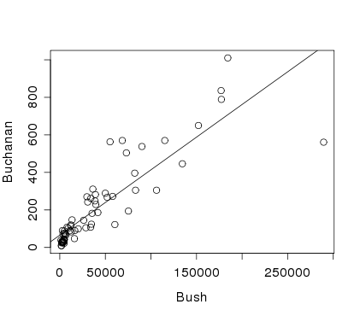
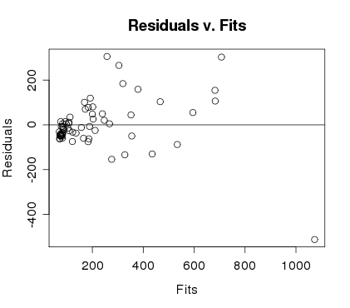
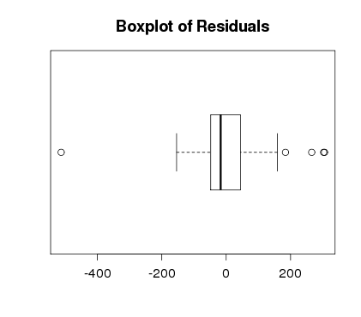
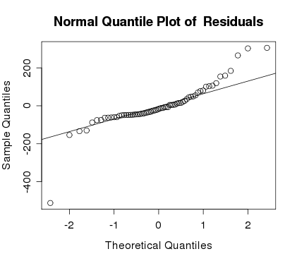
Palm Beach Omitted

Slide 28

Studentized Residual
Concern: An unusual value may exert great influence on the fit
⇒ Its residual might be underestimated because the model “moves” a lot to fit it
and/or
⇒ The standard error of regression may be inflated due to the outlier error
Studentize: Fit the model without that case, then find new $y−\hat{y}$ and ${\hat{σ}}_{ε}$ to standardize.
R does this for every point!

Slide 29
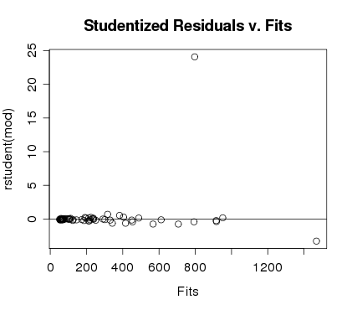
Studentized Residuals in R
Once you have fit mymodel=lm(Y~X)
Use: rstudent(mymodel)
Look for values
beyond ±2 (mild) or beyond ±3
Palm Beach

